Slide 1
Software Engineering
DUMISANI DUBE

Slide 2
CARE MASTERY PVT LTD
As a software engineer I would like to design and create a booking system for Care Mastery LTD, that will make it easy for clients to book appointments , edit, and also be able to cancel or delete the appointments if they are changes made.
The clients will be able to book the appointments during working hours 9 – 5 pm and also working days {Monday to Friday} and the bookings will be closed during weekends.
The client will be able to login, logout and also reset the password if it happens that the client forgets the password.
The booking system will be working on android, windows, IOS.
The client must be able to access the contact details of the company on the home page of the booking system

Slide 3
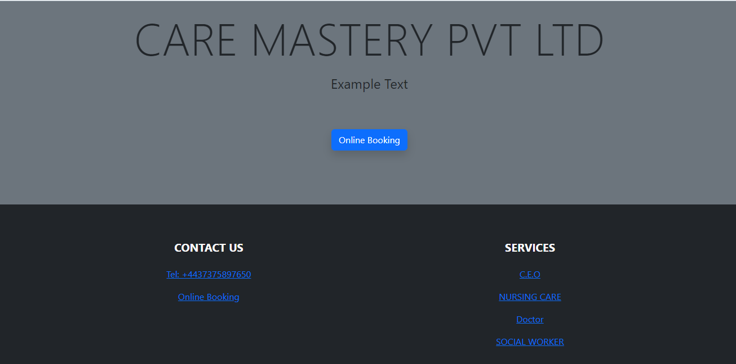
HOME PAGE
The booking system have got the name of the company on its home page .
The booking system home page consist of company phone number which makes the easy for the client to contact the company.
The home page also shows the health practitioner / services available at Care Master PVT LTD eg, Nursing care…. Doctor etc
The booking button is also available on the Home page to make it easy for the client to book the appointment without struggling a lot.

Slide 4
Requirements Specification
The booking system can do a lot of things : it provides time and date available for the booking.
A client can login and logout without any problems
A client can also change the password via e mail.
For the min time the customer cannot delete the appointment
On the booking system, a client can choose to book the Doctor, nurse, social worker
Appointments are saved automatically after a client submits the request
The booking system also consist of the staff panel where staff members can see who booked the appointment at what time.
The booking system got an option for editing but the client can only edit 24 hrs before the appointment

Slide 5

BOOKING SYSTEM SUMMARY

